Slide 1

Tackling climate change risks to financial stability: What role for prudential policy?
2023 RiskLab/BoF/ESRB Conference on Systemic Risk Analytics
[Please select]
[Please select]
8 July 2023
Paul Hiebert (European Central Bank)

Slide 2
Outline
1 | Background
2 | Distribution of financial risk
3 | Evolution of financial risk
4 | Systemic amplifiers
5 | Macroprudential considerations
6 | Summary

Slide 3
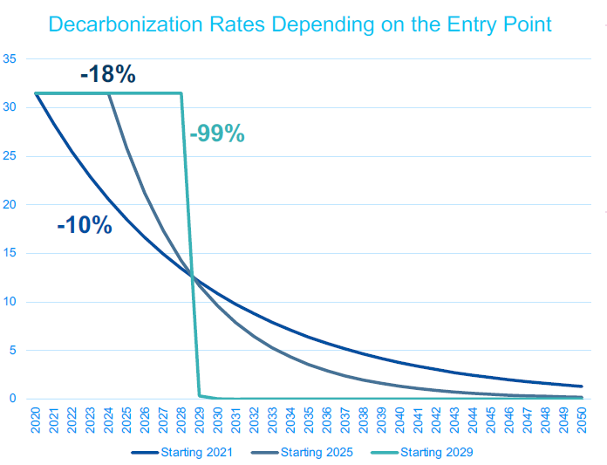
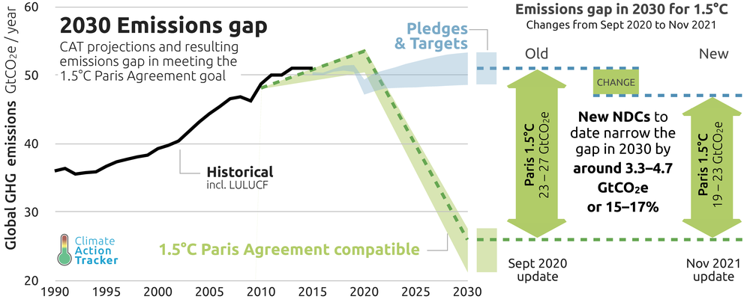
Climate shocks on the horizon, one way or another
    Projections for carbon emissions & warming
    (Emissions in gigatonnes of CO2 per year)
    Required decarbonisation rates depend on entry point
Transition risks
    Source: Climate Action Tracker
    Source: Bolton, P., Kacperczyk, M., and Samama, F. (2022). Net-zero carbon portfolio alignment. SSRN Mimeo, see https://ssrn.com/abstract=3922686
3

Slide 4
Outline
1 | Background
2 | Distribution of financial risk
3 | Evolution of financial risk
4 | Systemic amplifiers
5 | Macroprudential considerations
6 | Summary

Slide 5
Toward a surveillance framework
Exposure dimension
Risk dimension
Transition: Emissions (actual & forward-looking)
Physical: Climate-related hazards
(floods, wildfires, heatwaves,…)
Transition: Impact on profits & costs,
technological obsolescence, risk perceptions
Physical: Asset damages, insurance costs, production disruption
Non-financial
Institution-specific
To non-financial sectors
credit instruments (loans, debt sec., equity,…)
contingent liabilities (insurance, derivatives)
Vulnerability of counterparts: indebtedness, leverage, provisions
climate-related impact on credit risk (PD, LGD), market risk (asset valuation)
Financial
Climate: interdependent hazards
NFCs: In-/output interdependencies
Financial Institutions: overlapping exposures
Clustered risks, interconnectedness
Dynamic risk amplification & propagation
(joint defaults, contagion, fire sales)
System-wide
Source: ECB/ESRB (2022), The Macroprudential Challenge of Climate Change.

Slide 6
Mapping financial exposures
Bank credit registry
~4.2 million firms in euro area
Firms sample:
2.3 million European firms
Physical risk score
4.3 million firms worldwide (address level)
Transition risk
5 million firms worldwide
(4-digit NACE)
Firm financials
Orbis, Eikon, Bloomberg, iBACH
Security holdings data
~6.000 firms in euro area
Banks sample: ~400 consolidated banking groups in the euro area and 1,600 banks
Calculation of proxies to fill data gaps when matching to credit register
Source: Alogoskoufis et al (2021)

Slide 7
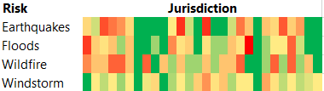
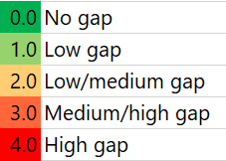
Physical risk exposures of banks are geographically concentrated
Firm exposures to physical hazards (Maximum firm exposure to physical hazards next 20 years)
Bank credit exposures to firms, by hazard (shares; percentages of total bank exposures to NFCs)
Protection gap for European countries by hazard (Index, A protection gap of 3 or above is expected to present material risk to the real economy)
Sources ECB/ESRB (2021), Climate-related risk and financial stability

Slide 8
Transition risk exposures are concentrated in economic sectors (both and across and within)
Euro area exposures to high and low emitting firms (percentages of total exposures and securities holdings)
Source: ECB Financial Stability Review, May 2022.
Firm-level emission intensities across and within euro area sectors (Emissions in tonnes of CO2 equivalents per USD million revenue)
Source: ECB/ESRB (2021), Climate-related risk and financial stability

Slide 9
Outline
1 | Background
2 | Distribution of financial risk
3 | Evolution of financial risk
4 | Systemic amplifiers
5 | Macroprudential considerations
6 | Summary

Slide 10
Medium- to long-term scenarios: Cost benefit analysis
Impacts of the NGFS net zero 2050 and delayed transition scenarios
GHG emissions,
    Network for Greening the Financial System scenarios
Gt CO2 / year
Delayed transition (2º)
Transition risk
Net zero 2050 transition (1.5º)
Current policies
Physical risk
Source: NGFS.
Source: ECB/ESRB (2022), The Macroprudential Challenge of Climate Change, NGFS.

Slide 11
Short term scenarios: Contours of transition given climate goals
EU emission reductions in three scenarios (percentage changes compared with 1990 levels)
Current and projected EU energy mix (percentages of total energy consumption)
Note: ECB Financial Stability Review, May 2023 edition. Based on European Environment Agency, Eurostat, NGFS and ECB calculations.
Notes: Panel a: Emission pathways refer to the EU aggregate. Temperature increases refer to the year 2100. Emission pathways until 2050 correspond to the NGFS’s Net Zero 2050 (+1.5°C), Nationally Determined Contributions (+2.6°C) and Current Policies (>+3°C) scenarios. Panel b: Brown sources for the energy sector include gas, coal and oil.

Slide 12
Modelling corporate stress test parameters
Source: ECB/ESRB (2022), The Macroprudential Challenge of Climate Change.

Slide 13
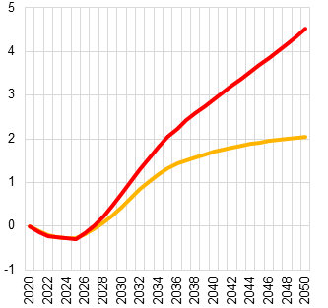
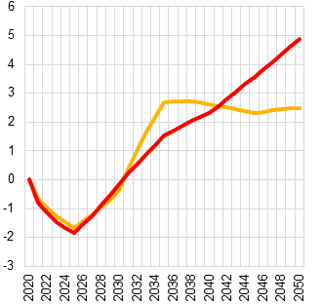
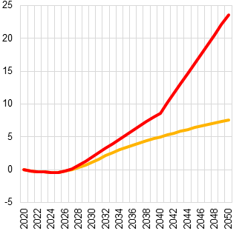
Corporate credit risk a function of underlying exposure to transition or physical risk
PDs: Median firm
PDs: Carbon intensive firms
PDs: High physical risk firms
All charts: % differences in adverse scenarios compared to orderly transition scenario
Massive long-term benefits of an orderly transition for firms most exposed to physical risk
Even more costly transition if delayed
More costly transition for carbon-intense firms, and more time needed to recoup investments
Short-term costs of OT
Long-term benefits of OT
Source: Alogoskoufis et al (2021), ECB economy-wide climate stress test

Slide 14
Outline
1 | Background
2 | Distribution of financial risk
3 | Evolution of financial risk
4 | Systemic amplifiers
5 | Macroprudential considerations
6 | Summary

Slide 15
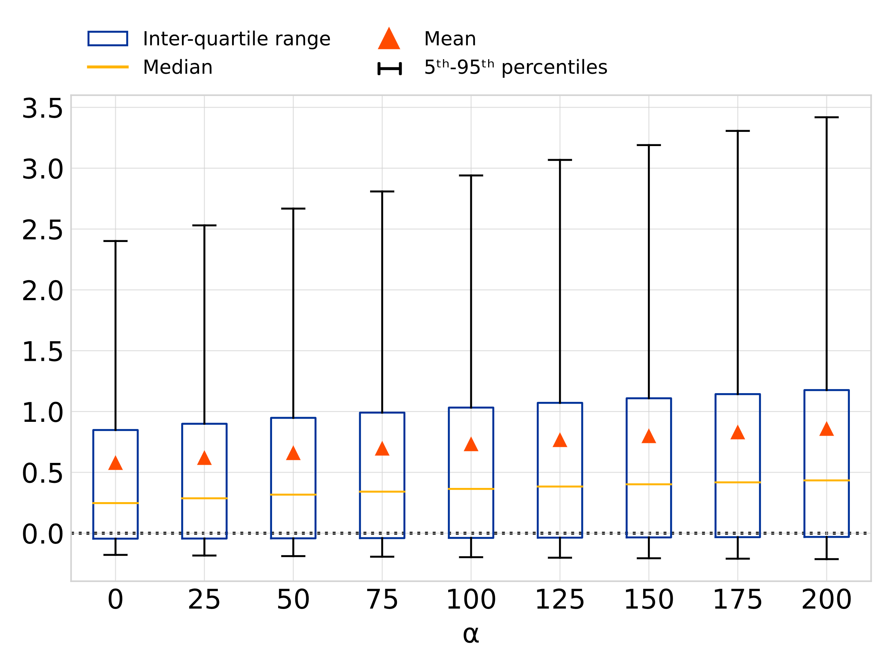
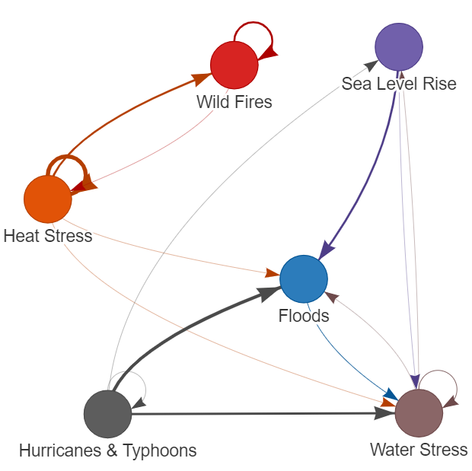
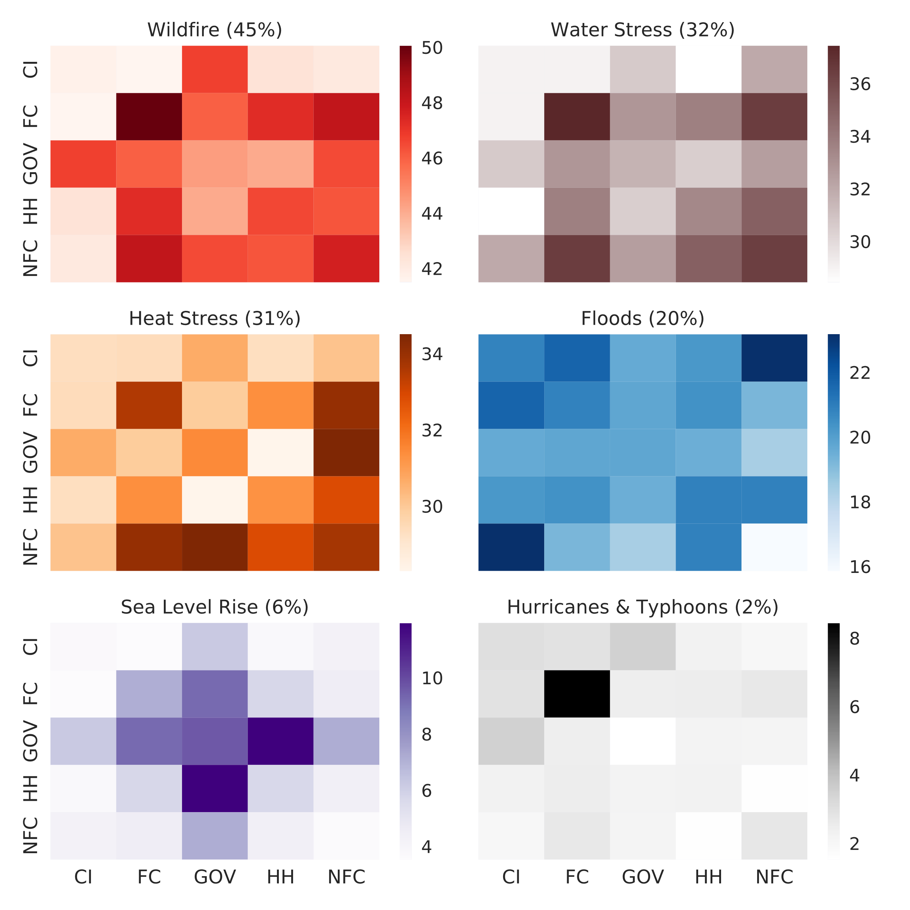


Systemic aspect #1: Correlated shocks and contagion
Materialisation of transition risk implies increased correlation of corporate defaults, with stronger increase in correlations for previously less correlated firms
Financial stability risks may be exacerbated by exposures to multiple interdependent hazards and self-reinforcing loops
Overlapping portfolios with exposures to transition or physical risks may imply loss amplification via fire sales among investors
Pairwise default correlations
for increasing transition risk intensity ($α$) [%]
Interdependencies of natural hazards
(Arrows based on hazards’ correlations and causal relations)
Physical-risk-weighted overlapping portfolios
Share of common asset holdings [%] (mean in parenthesis)
Increasing transition risk intensity
Note: Based on a multi-firm Merton model (A. Grassi and L. Mingarelli) and 500k bootstrapped Monte Carlo simulations on the full EA Moody’s Credit Edge sample. The transition risk intensity parameter $α=(1−β)T$ incorporates both the transition risk shock $T$as well as a pass-through factor $β$capturing the degree to which firms can pass the cost of a transition risk shock to consumers.
Sources: Left – Data from Gill and Malamud, “Reviewing and visualizing the interactions of natural hazards”, 2014, and ECB calculations. Right – Security Holding Statistics, 427, and ECB.
Notes: Left – Links refer to both correlations as well as causal links. Arrows’ thickness is proportional to a score capturing either increased probability or causal trigger of hazards, in terms of both spatial overlaps as well as temporal likelihood. Right – Overlapping portfolios weighted by physical hazards scores as share of common asset holdings by aggregate sectors.
Source: ECB/ESRB (2022), The Macroprudential Challenge of Climate Change.

Slide 16
Systemic aspect #1: Correlated shocks and contagion
System-wide interactions
Orderly transition relative to status quo. Primary axis: losses expressed in terms of total assets in the system, per cent mille (left-hand scale). Secondary axis: percentage
  Financial system interactions could imply a bumpy transition
  First round (exogenous) credit and market risk shocks versus second-round (endogenous) shocks
  Two layers of contagion
  Crossholdings of investment funds, and changes in the value of shares issued by open-end funds that are held by other funds.
  Overlapping exposures on the secondary market for securities, whereby investment funds may be exposed to common shocks, but may also affect one another by influencing market prices through sales and purchases.
Source: ECB/ESRB (2022), The Macroprudential Challenge of Climate Change.
Note: “Default, first-round” refers to firm defaults. “Market, first-round” refers to exogenous market losses both due to the market scenario and due to the price drop of exogenously defaulting firms issuing securities. “Second-round” losses are model-driven.

Slide 17
Systemic aspect #2: Spillovers
Euro area sectoral impacts of demand shocks
[percentage share of production]
Banks’ risk-weighted assets (RWA) below the MDA threshold
(percentages of total euro area risk-weighted assets))
Notes: Increases in PD refer to increases for firms hit by an average euro area output loss, with the credit quality associated with higher (lower) output loss deteriorating proportionally more (less). The sample includes 2,130 banks comprising significant institutions and less significant institutions.
Source: ECB/ESRB (2022), The Macroprudential Challenge of Climate Change.
Note: Results for the five most affected sectors only.

Slide 18
Systemic aspect #3: Risk transfer
Sovereign climate-related risks and link to financial stability
Note: ECB Financial Stability Review, May 2023 edition

Slide 19
Outline
1 | Background
2 | Distribution of financial risk
3 | Evolution of financial risk
4 | Systemic amplifiers
5 | Macroprudential considerations
6 | Summary

Slide 20
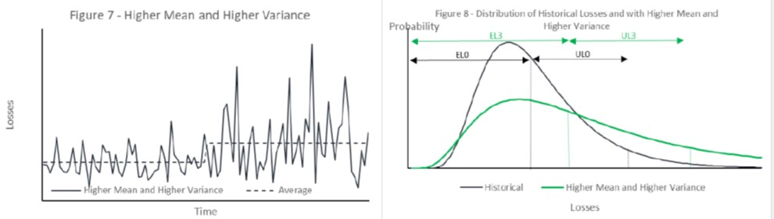
Stylised change in financial loss profile given climate shocks
Source: Holscher et al, 2022, “Climate Change and the Role of Regulatory Capital: A Stylized Framework for Policy Assessment”.

Slide 21
Developing a view on macroprudential policy
Relevance of a macroprudential approach to climate risk
Pervasive vulnerabilities at risk of repricing, amid externalities
Systemic aspects and risks cutting across sectors and potential arbitrage
A macroprudential approach to climate risks
Policy interplay
A macroprudential response should pull together with its microprudential counterpart
Macroprudential policies will both depend on, and also interact with, a broader set of public policies aimed at limiting and adapting to climate change
Careful design needed to avoid overlaps or unintended interactions, strong coordination paramount
Pillar 1
Banking sector
Concentration risk measures
Use of existing buffers
Potential new tools
Non-banks and financial markets
Concentration risk measures
Address insurance protection gap
Strengthen market standards (e.g. green bonds)
Policies
Source: ECB/ESRB (2022), The Macroprudential Challenge of Climate Change.
21

Slide 22
Three broad classes of macroprudential policy for climate risk
  Lender vulnerabilities
    absolute risk | relative risk
    capital | non-capital based
  Borrower vulnerabilities
  Informational failures
Source: ECB

Slide 23



Candidate macroprudential tools for the banking sector
Strong rationale
Neutral
Less suitable
Options | Intermediate Policy objective (ESRB/2013/1) | Possible application | Selected helpful attributes | Selected drawbacks
(Sectoral) Systemic risk buffer (SyRB) | Increase resilience; Limit concentration (for sectoral application) | increase resilience against materialization of risks from such exposures; Discourage exposure to certain geographical areas for physical risk and/or carbon critical “sector” for transition risk; | Very flexible | Challenging calibration, complex classification system, currently applicable for domestic exposures only
Concentration threshold | Limit concentration | Limit exposure to a certain geographical area for physical risk and to a certain carbon critical “sector” for transition risk | No additional capital; Targeted measures | Challenging calibration: complex classification system of sectors/geographical areas exposed to climate risk
Concentration charge | Increase resilience; limit concentration | A risk-weight capital add-on that applies once exposures to a certain sector or region particularly exposed to climate risk exceed a certain threshold. | Targeted measures | Challenging calibration; complex classification system of sectors/geographical areas exposed to climate risk
Sectoral requirements (Risk weights or minimum LGDs) | Increasing resilience | Higher risk weights or minimum LGDs could be required on exposures to high physical and/or transition risk. | mandatory reciprocity (limits arbitrage) | New complex tool; Challenging calibration; impact on microprudential requirements
Sectoral leverage Ratio | Increase resilience | Avoid over-leveraging of sectors or regions that are highly exposed to transitional or physical risks | Sectoral approach could allow for targeted increase in resilience | Would make the tool more complex and risk-sensitive, would deviate from its general function as non-risk-based backstop
Capital Conservation buffer (CCoB) | Increase resilience; Prevent build-up of risks | Buffer add-on during periods of excessive carbon-intensive credit growth | Capital already (partially) at the disposal of the banking system | Non-targeted measure, adaptions challenging
Countercyclical Capital buffer (CCyB) | Increase resilience; Prevent build-up of risks | Buffer add-on during periods of excessive carbon-intensive credit growth | -- | Cyclical nature of climate risk unclear, design changes needed, overlap with sectoral SyRB
Borrower based (BBMs) | Prevent build-up of risks | Could decrease vulnerability of households towards aspects of climate risks and change the pattern of demand towards more energy efficient houses or houses located in region less prone to physical risks | Very flexible, no additional capital | Gradual effect in resilience; targeting only specific portfolios, politically more sensitive
NSFR-LCR | Prevent market illiquidity | Could cover risks related to sudden repricing in financial markets | -- | Need for distinct climate features unclear
Systemic bank buffers (G/O-SII) | Misaligned incentive | Could cover bank-specific risks, for systemic institutions | -- | Climate risks are not specifically related to systemic importance of individual institutions.
Source: ECB/ESRB (2022), The Macroprudential Challenge of Climate Change.
23

Slide 24
Prudential policy interplay
Source: The macroprudential challenge of climate change
Note: This figure is for illustration purposes and not meant to be comprehensive

Slide 25
Outline
1 | Background
2 | Distribution of financial risk
3 | Evolution of financial risk
4 | Systemic amplifiers
5 | Macroprudential considerations
6 | Summary

Slide 26
Conclusions
  Climate shocks can embed systemic risk (cross section and time series dimensions)
    Concentrated financial exposures to climate change at regional, sectoral, and firm level
    The path to reduced climate risk may be bumpy, with near term tradeoffs inherent to climate risk benefits from action which only accrue with time, and strong distributional forces at play
    Systemic amplification channels include contagion, spillovers and risk transfer
  Macroprudential policies can address these systemic aspects of climate risk
    Make system less prone to climate-related risks or increasing loss-absorbing capacity
    Have a system-wide perspective, this preventing the migration of risks, and complementing microprudential efforts
    Depend on, and interact with, a broader set of policies aimed at adapting to climate change and limiting its impacts

